Slide 1
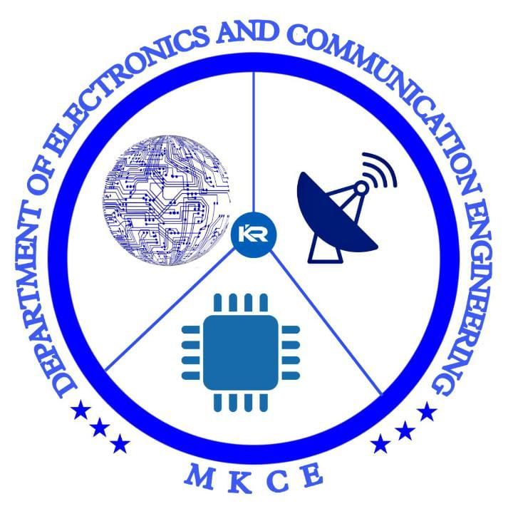


SMART BLINDSTICK USING ARTIFICIAL INTELLIGENCE
TEAM MEMBER:
GUIDED BY :
Mrs.M.SENTAMILSELVI
T.RATHIPRIYA (927621BEC162)

Slide 2
LIST OF CONTENTS
INTRODUCTION
ABSTRACT
PROBLEM STATEMENT
COMPONENTS
WORKING PRINCIPLE
APPLICATIONS
CONCLUSION

Slide 3
INTRODUCTION
Vision is the most important part of human physiology as most of the information human being get from the environment is via sight. Many people suffer from serious visual impairments preventing them from travelling independently. Here, we develop a tool for directing them when they move or walk.This will assist the blind persons during the walk and provides an alarm if any hurdle is detected within the set range.The stick which we made is foldable.Thus it is portable.

Slide 4
ABSTRACT
Smart Blind Stick is a device designed to help guide the visually impaired by detecting objects and portray the information to them in the form of speech. This reduces the human effort and gives better understanding of the surrounding. Furthermore it also provides an opportunity for visually impaired people to move from one place to another without being assisted by others. The device can also be used in old age homes where old age people have difficulty in their day to day activities due to decreased vision.

Slide 5
PROBLEM STATEMENT
A survey by WHO (World Health Organization) carried out in 2011 estimates that in the world, about 1% of the human population is visually impaired (about 70 million people) and amongst them, about 10% are fully blind (about 7 million people) and 90% (about 63 million people) with low vision. The main problem with blind people is how to navigate their way to wherever they want to go. Such people need assistance from others with good eyesight. As described by WHO, 10% of the visually impaired have no functional eyesight at all to help them move around without assistance and safely. This study proposes a new technique for designing a smart stick to help visually impaired people that will provide them navigation.

Slide 6
COMPONENTS
Arduino UNO
Ultrasonic Sensor
Buzzer
Battery
Jumper Wires
A stick or A Pipe

Slide 7
WORKING PRINCIPLE
First of all, we should have understood why we are using Ultrasonic sensors for this project.
Here we placed sensor at the lower part of the walking stick.
It is used to detect objects which are near to the person.
When we turn on the circuit power supply, at the same time the ultrasonic sensors are transmitting ultrasonic sound waves from the transmitter parts.
When any objects come in front of these sensors, then the ultrasonic sound waves reflect back from the object surface to the sensor receiver part, then the sensor receives this wave and generates Output.

Slide 8
This output data goes to the Arduino UNO.
Then the Arduino calculates the distance between the sensor and the objects.
If the sensors detects the obstacle, Then the Arduino sends operating voltage to the Buzzer and the Vibrating motor.
Now the buzzer generates sound and the motor start Vibrating.

Slide 9
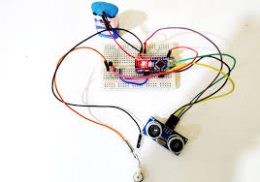

Slide 10
APPLICATIONS
Obstacle Detection: AI-powered sensors identify obstacles and provide real-time alerts to enhance user safety.
Object Recognition: Utilizing computer vision, the device recognizes and describes surrounding objects and landmarks.
Navigation Assistance: AI algorithms offer route planning, optimizing paths based on real-time data for efficient travel.
Voice Interaction: A voice-controlled virtual assistant provides hands-free information, aiding users in daily tasks and interactions.

Slide 11
CONCLUSION
The project proposed the design and architecture of a new concept of smart electronic guiding stick for blind people. The advantage of the system lies in the fact that it can prove to be very low cost solution to millions of blind person worldwide.
It can be further improved to have more decision taking capabilities by employing varies types of sensors and thus could be used for different applications.
It aims to solve the problems faced by the blind people in their dailylife .The system also takes measures to ensure their safety.

Slide 12
REFERENCES
1. IMTC - International Instrumentation and Measurement Technology Conference, Proceedings. 1255-1258. 10.1109/I2MTC.2012.6229180.
2. Nada, Ayat & Mashali, Samia & Fakhr, Mahmoud & Seddik, Ahmed. (2015). “Effective Fast Response Smart Stick for Blind People”. 10.15224/978-1-63248-043-9-29.
3.M.Everingham, S.M.A.Eslami, L.Van Gool, C.K.I.Williams, J.Winn, and A.Zisserman. The pascal visual ob-ject classes challenge: A retrospective. International Journal of Computer Vision, 111(1):98– 136, Jan. 2015.
4. L. Chen, J. Su, M. Chen, W. Chang, C. Yang and C. Sie, "An Implementation of an Intelligent Assistance System for Visually Impaired/Blind People," 2019 IEEE International Conference on Consumer Electronics (ICCE), Las Vegas, NV, USA, pp. 1-2, 2019.

Slide 13



